Slide 1

Welcome

Slide 2
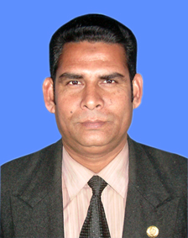
Presented by-
Golam Mostafa
Assistant teacher
Madhupur Mohila Alim Madrasah
Pushpapara, Pabna.

Slide 3
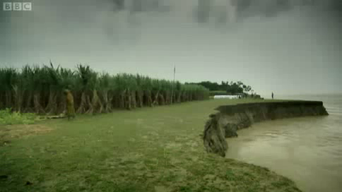
Class: Nine
Subject: English

Slide 4
Learning Outcomes
At the end of this lesson, the students will be able to-
Read the text of “The Greed of The Roaring Rivers”
Identify new words and find its meaning
Watch/Listen to a video clip
Use appropriate words to write meaningful sentences
Converse on the effects of river erosion

Slide 5
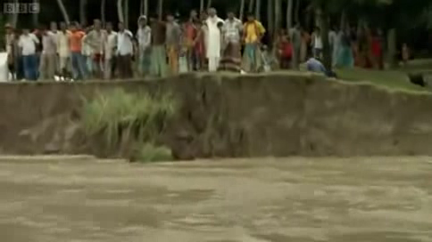
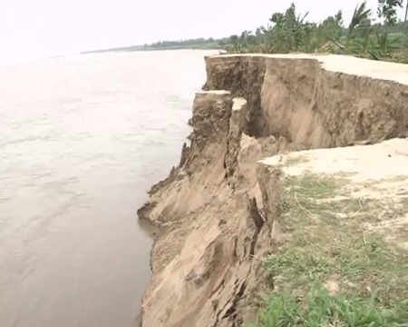
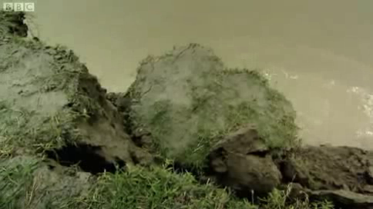
Look at the pictures and guess today’s topic

Slide 6

So, our
Today's Topic
is-------------.

Slide 7
The greed of the roaring rivers
Unit 5, Lesson-01, Page-66

Slide 8
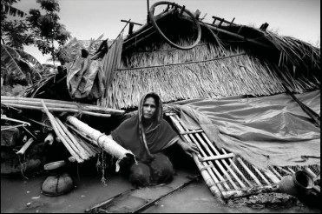
Meherjan lives in a slum on the Sirajgonj Town Protection Embankment. Her polythene roofed shelter looks like a cage. She is 45 but looks more than her age.
The Greed of The Roaring Rivers
Reading

Slide 9


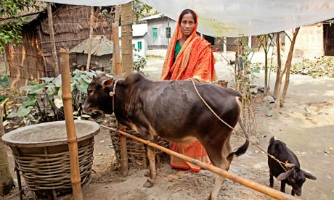
Not long ago Meherjan had everything --- a family, cultivable land and cattle.

Slide 10
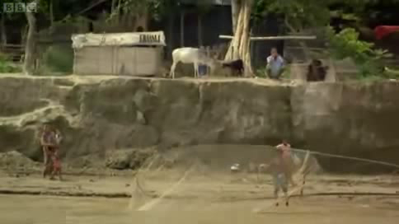
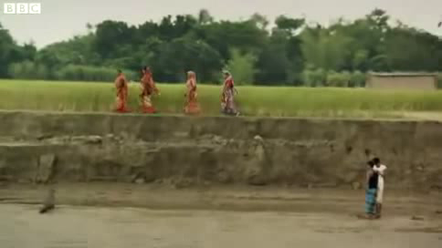
The erosion of the Jamuna consumed gradually all her landed property. It finally claimed her last shelter during the last monsoon.

Slide 11
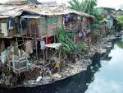
Vocabulary
An area of a city that is very poor where the houses are dirty and in bad condition.
Slum
Meherjan lives in a slum on the Sirajgonj Town.

Slide 12
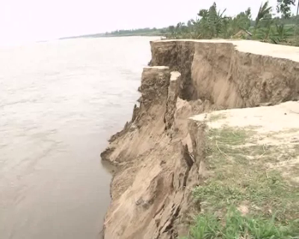

Embankment-
Bank, Dam, Ridge, Guard, Edge
Meherjan lives in a slum on the Sirajgonj Town Protection Embankment.

Slide 13



Cage
A structure made of metal bars or wire in which animals or birds are kept.
Meher’s polythene roofed shelter looks like a cage.

Slide 14
Individual Work (writing)
Complete the summary of Meherjan’s life with appropriate words/phrases:
slum dweller
homeless
victims
due to
shortage of food
Meherjan is a typical (1) --------------- woman who lives in a slum. She lost her shelter and properties (2) --------------- the erosion of river Jamuna. She also lost her family. Her husband died of diseases caused by poverty and (3) ---------------. Now, she is only a (4) ---------------. Like Meherjan there are many people who have become the (5) ------------- of river erosion.

Slide 15
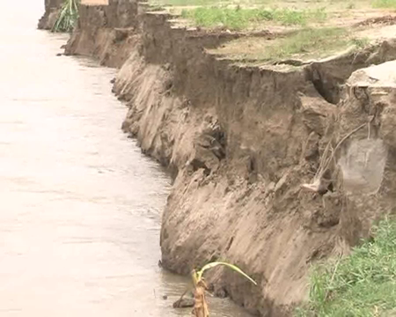
Group work: Speaking
Watch the video clip and converse on the effects of river erosion
What is river erosion?
What are the effects of river erosion?

Slide 16
Home work
Write a short paragraph on the causes and effects of river erosion.

Slide 17
Thank you

